Slide 1
Continuous Integration
SE489: DevOps Engineering

Slide 2
Outline
Why we need Continuous Integration?
What is Continuous Integration?
What is Jenkins?
Jenkins Distributed Architecture
Hands on

Slide 3
Why we need Continuous Integration?

Slide 4
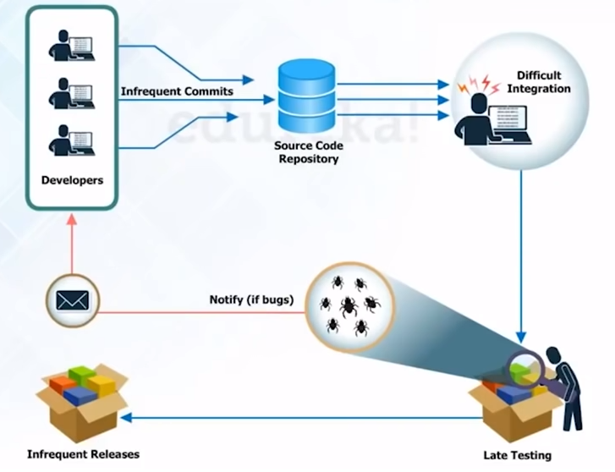
Before Continuous Integration

Slide 5

Problems Before Continuous Integration
Developers have to wait till the complete software is developed for the test results
If the test fails, then locating and fixing bugs is very difficult. Developers have to check the entire source code of the software
I hope the code works fine in testing
I have to check the entire source code
Code

Slide 6
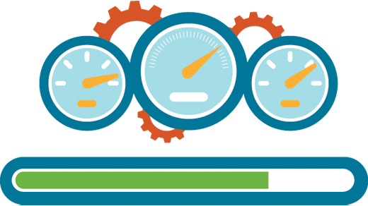

Problems Before Continuous Integration
Software delivery process was slow
Continuous feedback pertaining to things like coding or architectural issues, build failures, test status etc. was not present
Build, Measure, Learn

Slide 7
Before Continuous Integration

Slide 8
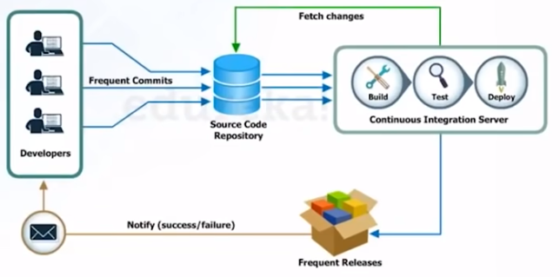
Continuous Integration – to the rescue
Since after every commit to the source code an auto build is triggered, it is automatically deployed on the test server
If the test results show that there is a bug in the code, then developers only have to check the last commit made to the source code
It increases the frequency of new software releases
The concerned teams are always provided with the relevant feedback

Slide 9
Continuous Integration – to the rescue
Before Continuous Integration
The entire source code was built and then tested
Developers have to wait for test results
No Feedback
After Continuous Integration
Every commit made in the source code is built and tested
Developers know the commit tests results
Feedback is present

Slide 10
What is Continuous Integration?

Slide 11
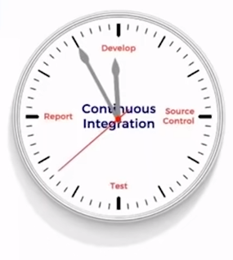
What is Continuous Integration?
Continuous Integration is a development practice in which developers are required to commit changes to the source code in a shared repository several times a day or more frequently
Every commit made in the repository is then built. This allows the teams to detect the problems early
Commit Changes to the Source Code
Feedback
Continuous Integration Server
Build the Code
Test
Deploy

Slide 12
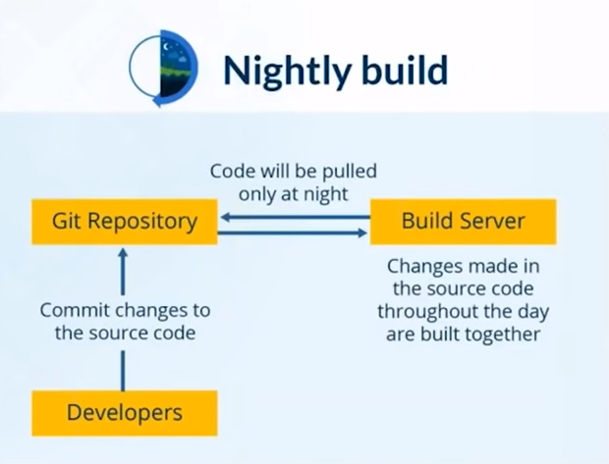
Continuous Integration Case Study (Nokia)
Problem Statement

Slide 13

Continuous Integration Case Study (Nokia)
Solution

Slide 14

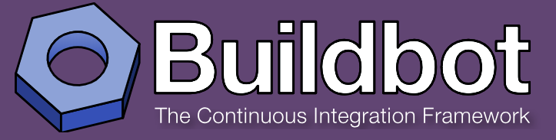


Continuous Integration Tools

Slide 15
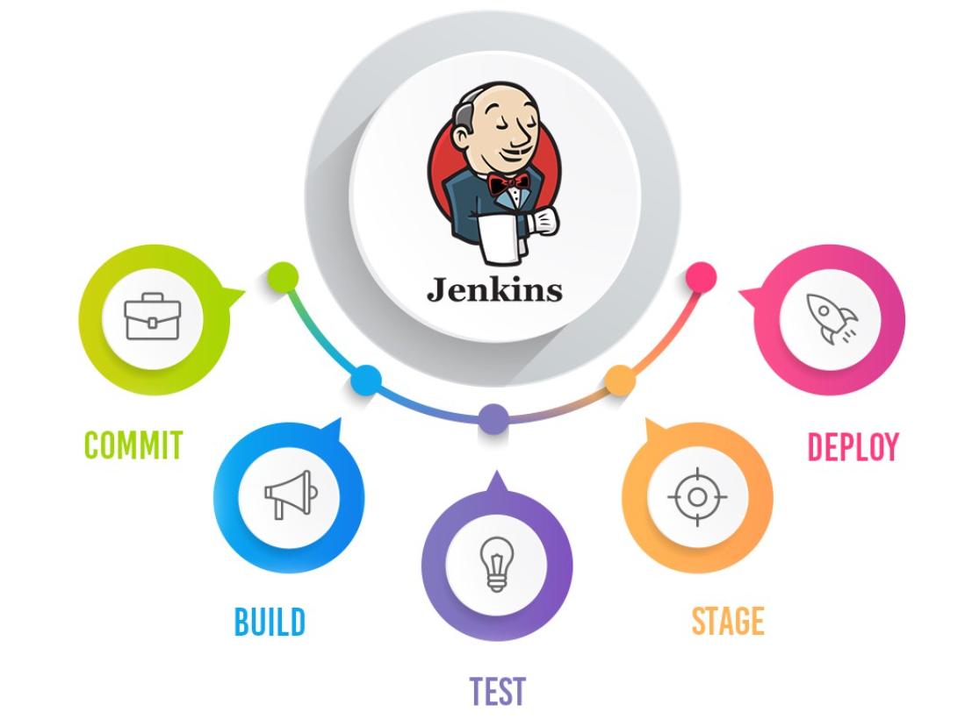
What is Jenkins?

Slide 16
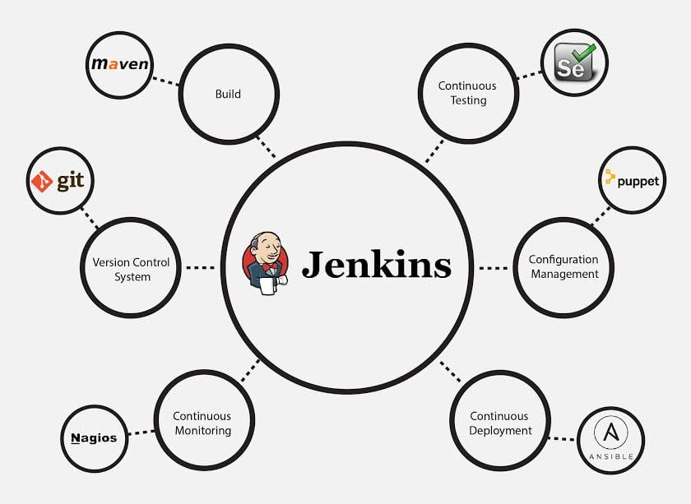
What is Jenkins?
Jenkins is an open source automation tool written in Java with plugins built for Continuous Integration purposes.
Plugins that will allow the integration of various DevOps stages.

